Slide 1


Learned Reverse ISP with Soft Supervision
Beiji Zou^{1,2}, Yue Zhang^{1,2}
1.School of Computer Science and Engineering, Central South University,Changsha 410083, China
2.Hunan Engineering Research Center of Machine Vision and Intelligent Medicine,Changsha 410083, China
Presenter: Yue Zhang
23rd Oct , 2022
https://github.com/yuezhang98/Learned-Reverse-ISP-with-Soft-Supervision

Slide 2
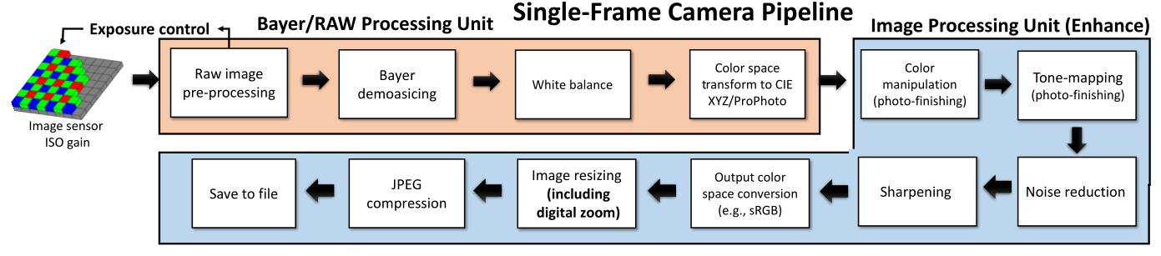
Background
Classical Image Signal Processor (ISP)^{[1]}
RAW image usually has a high dynamic range
more information and helpful for image processes
RGB-to-RAW mapping: high dynamic range is ignored
[1] Delbracio, M., Kelly, D., Brown, M.S., Milanfar, P.: Mobile computational photography: A tour. arXiv preprint arXiv:2102.09000 (2021)

Slide 3
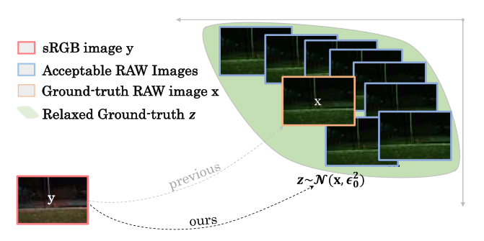
Our work：The proposed soft supervision
Simplifying the learning process
Implicit data augmentation

Slide 4
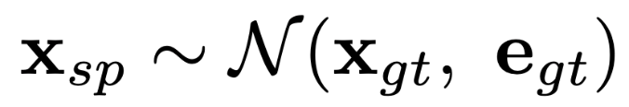
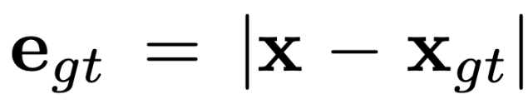


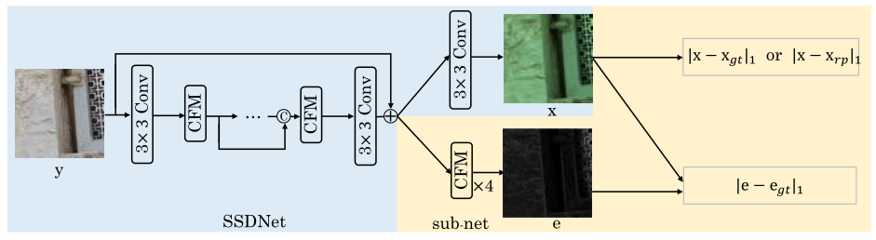
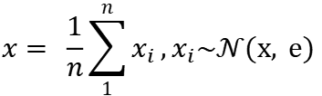
Our work：Learning paradigms for soft supervision
Soft Supervision： ,
1. Directly learning, them sampling in testing time:
$$x= \frac{1}{n}\sum_{1}^{n}{x_{i}},x_{i}\sim 𝒩(x, e)$$
test-resampling, then averaging multiple times.
2. Sampling in the training phrase:
training-resampling, only one time!
3. Implement details:

Slide 5
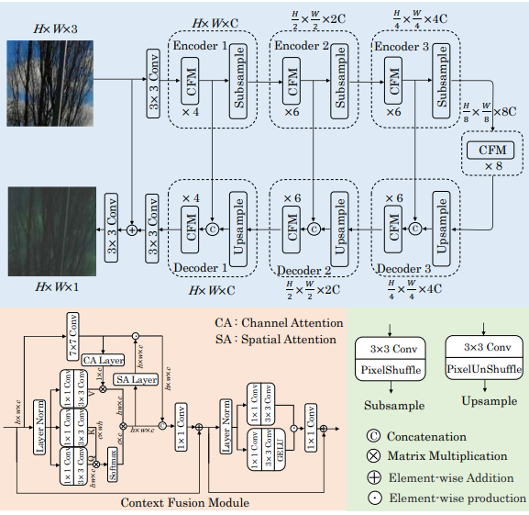
Our work: SSDNet
Encoder-Decoder framework
Context Fusion Module
Convolution and Transformer Based

Slide 6
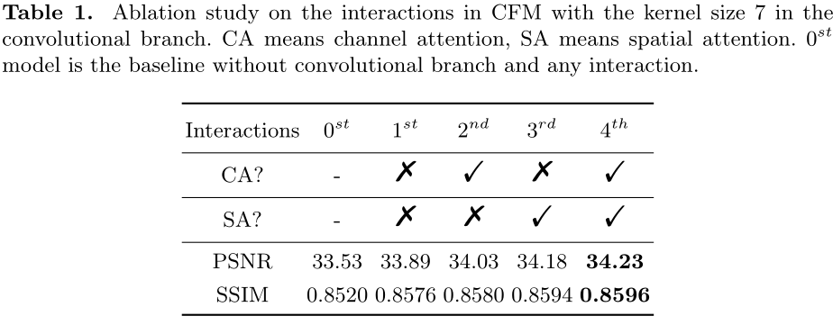
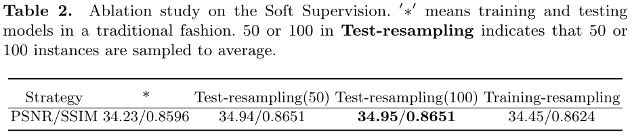
Experiments: Ablation Studies

Slide 7
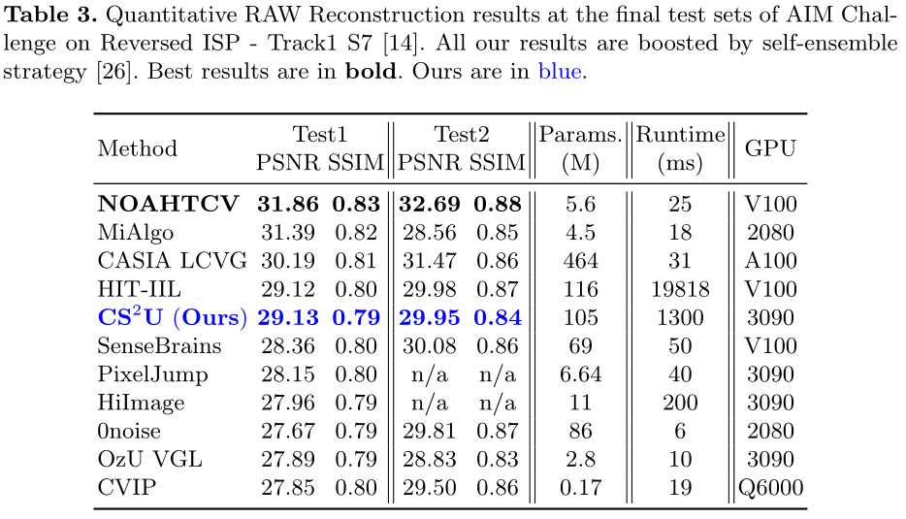
Experiments: AIM Reversed ISP Challenge

Slide 8
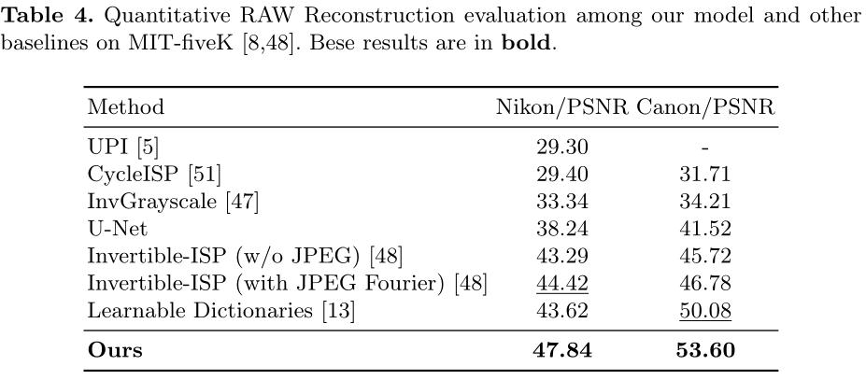
Experiments: RAW Reconstruction

Slide 9
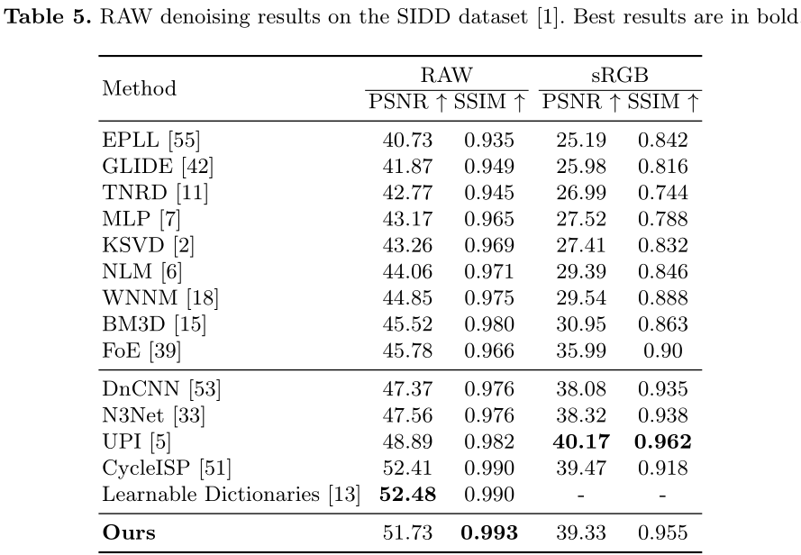
Experiments: Application to Image Denoising

Slide 10
Summary
Contributions
propose a new learning target for data-driven RGB-to-RAW mapping
propose a novel network SSDNet, that effectively fuses convolution and transformer
our method achieves state-of-the-art RAW restoration from RGB image
Discussions
this research can be a valid tool for RAW image denoising

Slide 11
Thanks!

